Slide 1
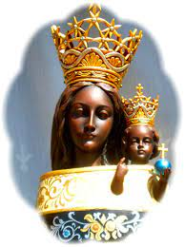
機場 天主教教友團體 Airport Catholic Community

Slide 2
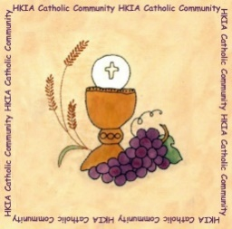
機場天主教教友團體 恆常活動*
Airport Catholic Community Regular Activities*
歡迎與我們聯絡Please contact : airportcatholiccoommunity@gmail.com
彌撒Mass 逢星期五 Every Friday 12:45 – 13:20 | 機場一號客運大樓七樓祈禱室A行段 (非禁區) Terminal 1, L7, Prayer Room, Aisle A (non-restricted area)
*公眾假期除外 Except Public Holidays

Slide 3
機場天主教教友團體 恆常活動*
Airport Catholic Community Regular Activities*
歡迎與我們聯絡Please contact : airportcatholiccoommunity@gmail.com
Meeting Room
慕道班 Catechists 逢星期四 Every Thursday 12:50 – 13:50 | 機場行政大樓及透過MS Teams視訊 HKIA Tower + MS Teams
*公眾假期除外 Except Public Holidays

Slide 4
機場天主教教友團體 恆常活動*
Airport Catholic Community Regular Activities*
歡迎與我們聯絡Please contact : airportcatholiccoommunity@gmail.com
Meeting Room
聖母軍Legion of Mary 逢星期四 Every Thursday 18:30 - 20:00 | 機場行政大樓 HKIA Tower
*公眾假期除外 Except Public Holidays

Slide 5
機場天主教教友團體 恆常活動*
Airport Catholic Community Regular Activities*
歡迎與我們聯絡Please contact : airportcatholiccoommunity@gmail.com
Meeting Room
時辰祈禱Liturgy of the Hours 每月第一個星期三First Wednesday 12:40 – 13:10 | 機場行政大樓及透過MS Teams視訊 HKIA Tower + MS Teams
*公眾假期除外 Except Public Holidays

Slide 6
機場天主教教友團體 恆常活動*
Airport Catholic Community Regular Activities*
歡迎與我們聯絡Please contact : airportcatholiccoommunity@gmail.com
Meeting Room
泰澤共融祈禱Airport Common Prayer 每月第二個星期三Second Wednesday 13:00 – 13:40 | 機場行政大樓及透過MS Teams視訊 HKIA Tower + MS Teams
*公眾假期除外 Except Public Holidays

Slide 7
機場天主教教友團體 恆常活動*
Airport Catholic Community Regular Activities*
歡迎與我們聯絡Please contact : airportcatholiccoommunity@gmail.com
Meeting Room
每月分享Monthly Sharing 每月第四個星期三Fourth Wednesday 12:50 – 13:50 | 機場行政大樓及透過MS Teams視訊 HKIA Tower + MS Teams
*公眾假期除外 Except Public Holidays

Slide 8
機場天主教教友團體 恆常活動*
Airport Catholic Community Regular Activities*
歡迎與我們聯絡Please contact : airportcatholiccoommunity@gmail.com
於2022年6月30日，機場天主教教友團體包括來自超過20間公司已登記在郵寄名單上的140成員
As of 30 June 2022, ACC comprises:
Membership: 140 individuals registered on mailing list, Coming from over 20 different companies

Slide 9
機場天主教教友團體 恆常活動*
Airport Catholic Community Regular Activities*
歡迎與我們聯絡Please contact : airportcatholiccoommunity@gmail.com
機場牧民團隊包括：
來自東涌聖母訪親堂3位司鐸及3位終身執事
核心工作小組 + 每項活動專責工作小組
Chaplaincy consists of
3 Parish Priests and 3 Permanent Deacons from Tung Chung Visitation Parish
Core Working Group + a working group for each activity

Slide 10
謝謝Thanks

